Slide 1
Promoting Discourse: Mystery Bags, Speed Dating, Cultural Context & QR Codes
Mark Ellis & Susanna Meza
CSU Fullerton
Valadez Middle School
NOYCE Fellowship MT2 Project

Slide 2
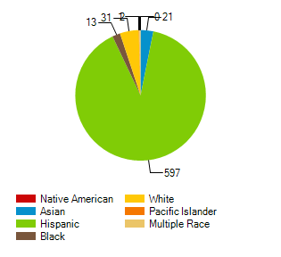
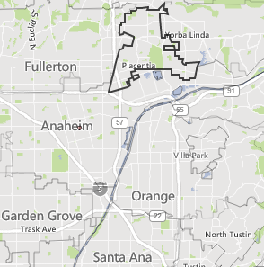
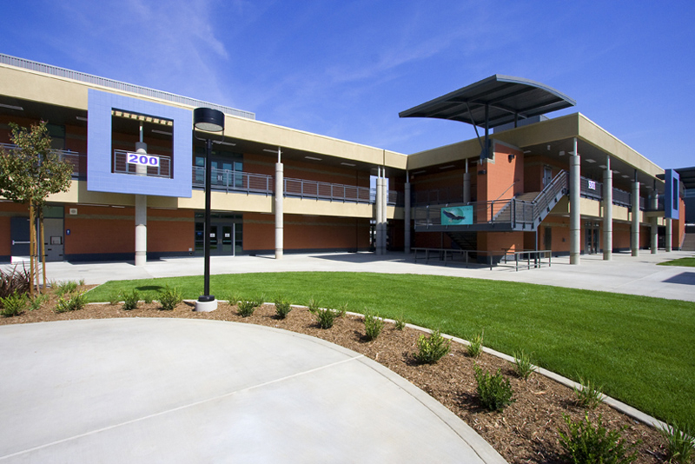
Context

Slide 3
Objectives of Presentation
Demo Activities
How To Do It Yourself
Research Base

Slide 4
Sense-Making, Discourse, and Culture in Mathematics Learning
Students must have opportunities to…
Learn mathematics through reasoning and sense-making. (Ellis, 2007)
Engage in meaningful mathematical discussion. (Staples & Colonis, 2007)
See themselves in mathematics and mathematics as part of themselves. (Nasir, Hand, & Taylor, 2008)
Use language and culture as tools for mathematics learning. (Irizarry, 2007)

Slide 5
Discourse & English Language Development (ELD)
Allows for repetition of linguistic terms and thinking processes
Pushes learners to organize their thoughts, negotiate meaning, back claims with evidence, ask for clarification
Requires learners to produce language
Allows learners to see how others think
(Zwiers & Crawford 2011)

Slide 6
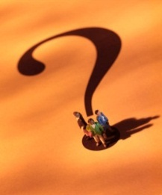
My Question
How can I better meet the needs of my students, including my ELLs, to support their mathematical success and prepare them for CCSSM?

Slide 7
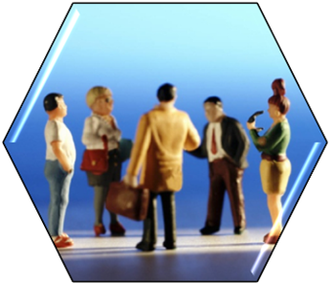
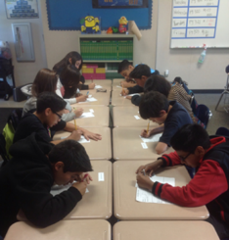
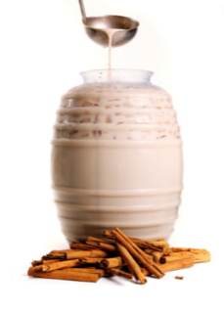
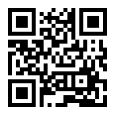
Focus Activities
Mystery Bags
Word cards and artifacts
Speed Dating
Several prompts based on same mathematical topic
Mathematics in a Cultural Context
What it is, and what its not.
QR Code
Quick Response

Slide 8
Mystery Bags
Artifacts are chosen to pull out of the bag one at a time.
Key words are written on a card and may be pulled out of the bag as well.
Students will be asked to find a mathematical connection between the items pulled out and the words shown.

Slide 9
Face

Slide 10
Face
Height

Slide 11
Face
Height
The Great Pyramid

Slide 12
Face
Height
The Great Pyramid
Base
Vertex

Slide 13
Time to get Started!
No peeking!!

Slide 15
Speed Dating with Math
Class is set up like a speed date session.
Two individuals will be given the same mathematical problem and will be asked to work together to write, solve, and explain their understanding.
The bell will ring signaling half
the class to move on to the next
person while the other half remains
seated waiting to receive their next
“math date”

Slide 16
Speed Dating with Math (cont’d)
Students will then switch information (switch cards) and will be asked to solve each others problem. If they are unsure they turn to their partner for additional information to aide them in solving and understanding the problem

Slide 18
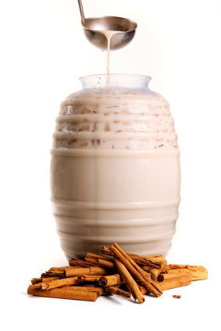
Math in a Cultural Context
To make delicious Horchata you need cups
of sugar per 1 gallon of water. How many cups of sugar would you use for 6 gallons of water?

Slide 19
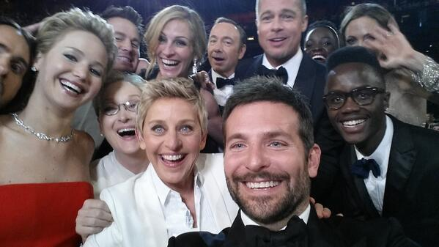
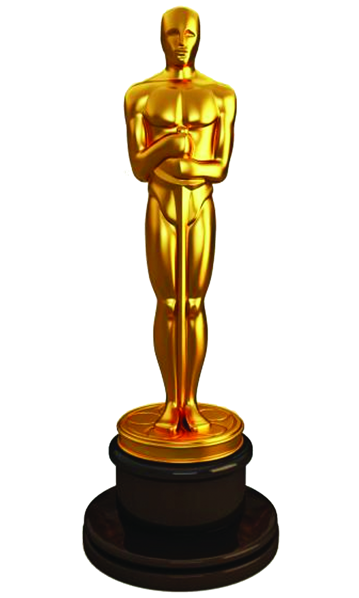
#Oscars #Bestphotoever
Ellen posted this picture on twitter last night. In just 1 second she had about 250 likes. Keeping this rate, how many likes do you think she had after one hour?

Slide 20
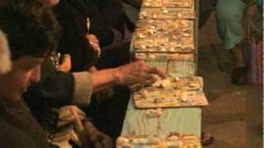
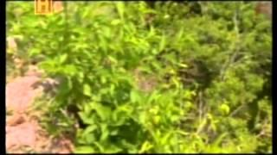
Math in a Cultural Context
https://www.youtube.com/watch?v=J3YW9HBtT8g
https://www.youtube.com/watch?v=1mL-Dqpg_w8
La loteria
El cenote sagrado
You pay 10 pesos to play the loteria. You win 32 pesos, and the next round you decided to play again and pay 30 pesos. You lose the second round and pay 20 pesos on the third round where you win 12 pesos. How much pesos do you end with at the end of the three rounds?
To dig up the artifacts from the cenote, Edward Thompson had to decrease 20 meters before reaching the water. He then had to decrease another 15 meters. How far did Thompson have to go to dig up the artifacts?

Slide 21
Culturally/Community Relevant Teaching
Curriculum
Teach in a way students can understand.
Use student-centered stories, vocabulary, and examples.
Incorporate relatable aspects of students' lives.

Slide 22
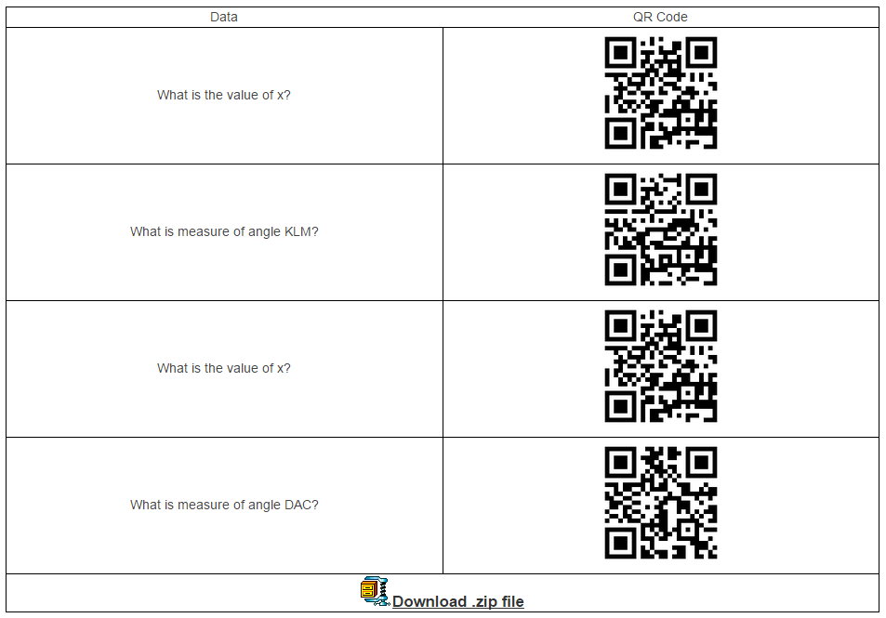
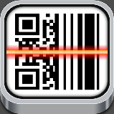
QR Code
You will need to create QR codes.
Visit QR Code Generator
Have students download
Quick Scan
OR
QR Reader

Slide 23
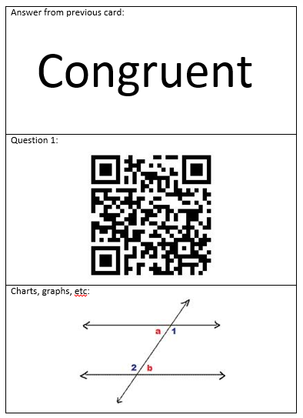
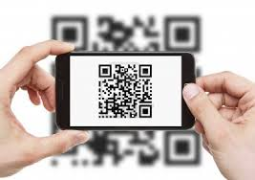
QR Code
Once the forms are created and posted students are ready to get up and go!

Slide 24
Closure
Weebly website
http://mathdiscourse.weebly.com/
Check out additional activity samples.
EDMODO Account
Search for Susie Meza

Slide 25
References
Cirillo, M. (2013). What are some strategies for facilitating productive classroom discussions? NCTM Research Brief. http://www.nctm.org/news/content.aspx?id=35386
Ellis, M. W. (2007). Constructing a personal understanding of mathematics. Mathematics Teacher, 100(8), 518-522.
Irizarry, J. G. (2007). Ethnic and urban intersections in the classroom: Latino students, hybrid identities, and culturally responsive pedagogy. Multicultural Perspectives, 9(3), 21-28.
Nasir, N. S., Hand, V., & Taylor, E. V. (2008). Culture and mathematics in school: Boundaries between “cultural” and “domain” knowledge in the mathematics classroom and beyond. Review of Research in Education, 32, 187-240.
Staples, M., & Colonis, M. M. (2007). Making the most of mathematical discussions. Mathematics Teacher, 101(4), 257-261.
Zwiers, J., & Crawford, M. (2011). Academic Conversations: Classroom talk that fosters critical thinking across disciplines. Portland, ME: Stenhouse.

